Slide 1
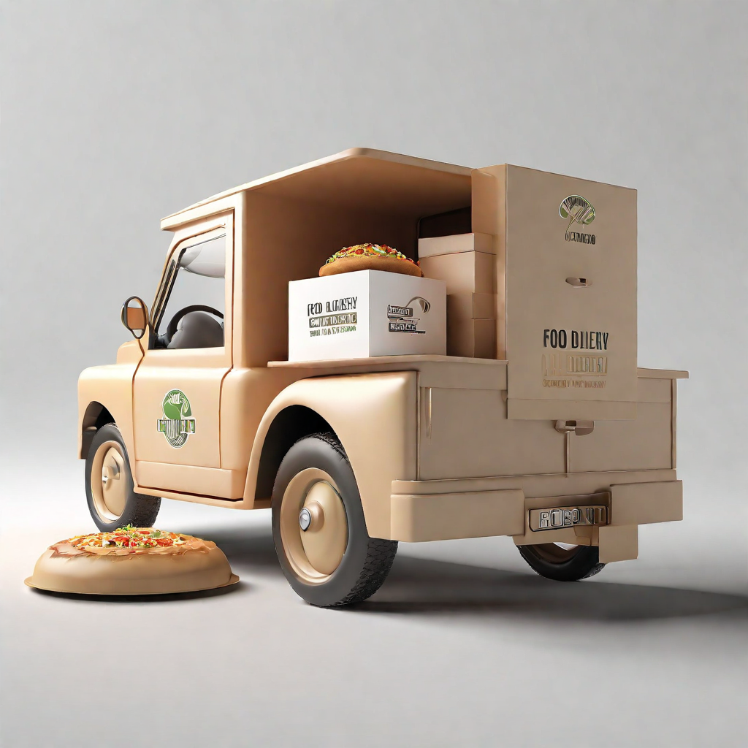
Swiggy Project Report

Slide 2
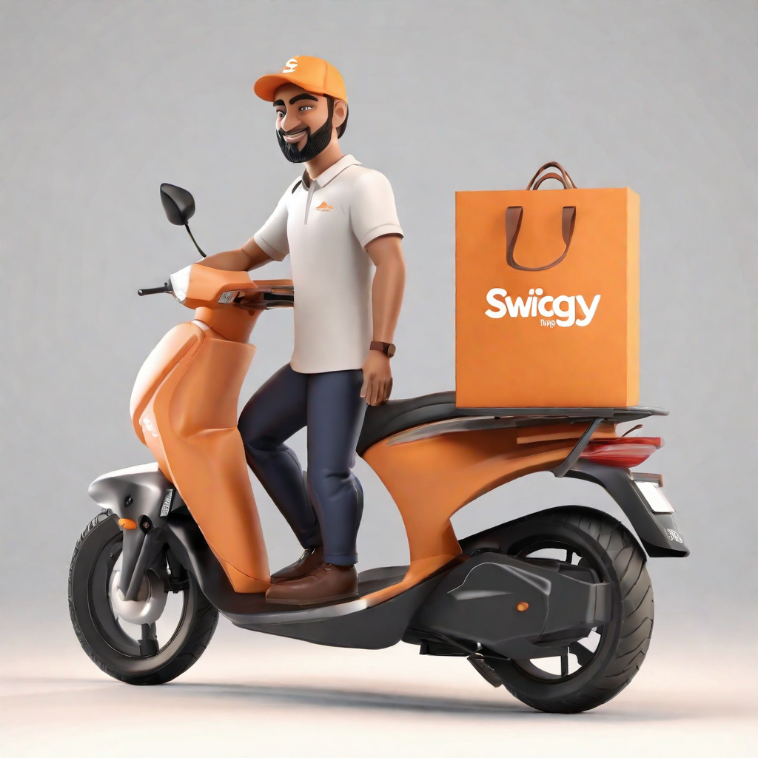
Project Objective
To construct a consolidated and interactive Power BI report that will allow Swiggy to quickly assess the required data.

Slide 3

Benefits
Take the Business insights.
We can find Total Shop, Total cuisine, Average rating, Average cost for one person.
Easy to filter the Restaurants according to rating and price.
we can see Top and Bottom rated Restaurants.
we can find location wise rating.
Increased Business for Restaurants.

Slide 4
Data Sharing Agreement
Sample file name (Swiggy Bangalore Outlet Details.CSV) collected from INeuron
Number of Columns : 5﻿
Column names : (Shop_Name, Cuisine, Location, Rating, Cost_for_two )
Number of Rows : 119
Column data type: text

Slide 5
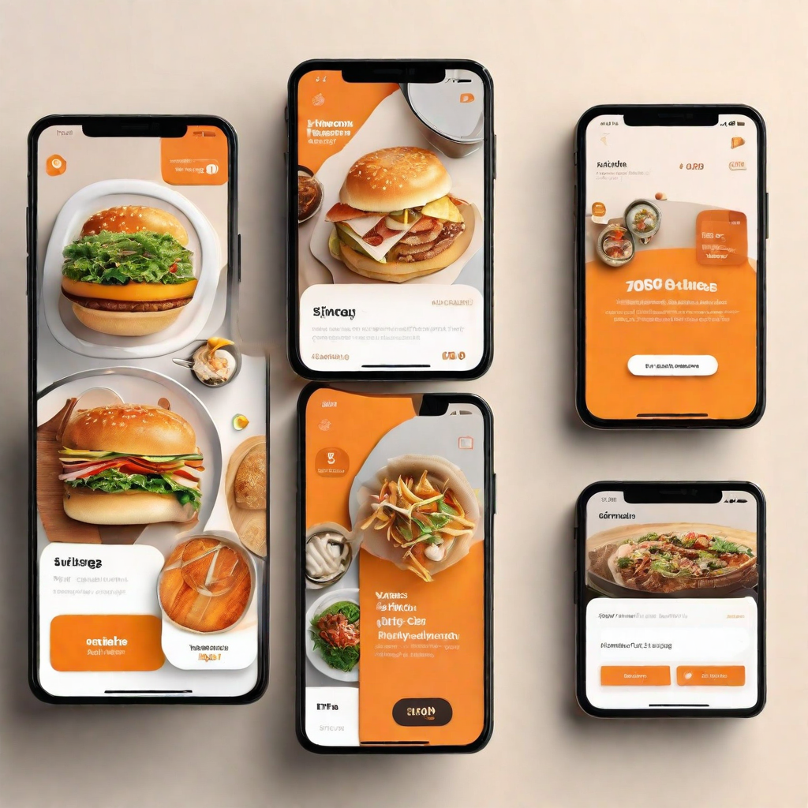
Technology Stack
Technologies Used
Microsoft Excel
Python
Power BI

Slide 6
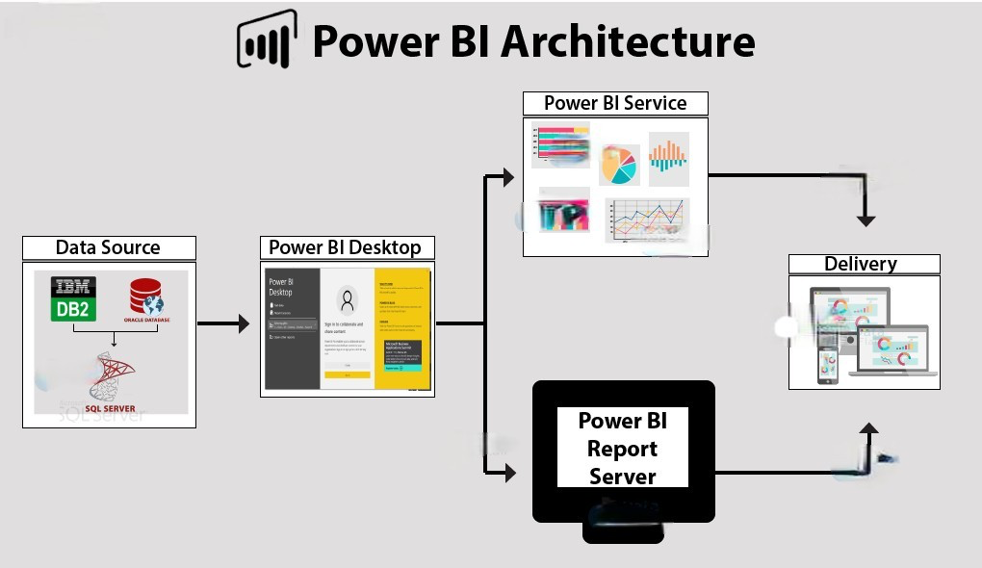

Slide 7
Data Validation and Data Transformation :
Data Check:
Open data in Excel and check
Load Data:
Open Power BI and load Excel file.
Transform
Filter out irrelevant data.
Handle null values and in consistencies.
Create column and Measure according to insights.
Data Visualisation and Report
Take insights from data and create chart and graph to represent the data.
Deployment
Deploy reports and dashboards to the Power BI Service for cloud-based access.
Governance and maintenance
Establish governance policies for Power BI usage within the organisation.

Slide 8
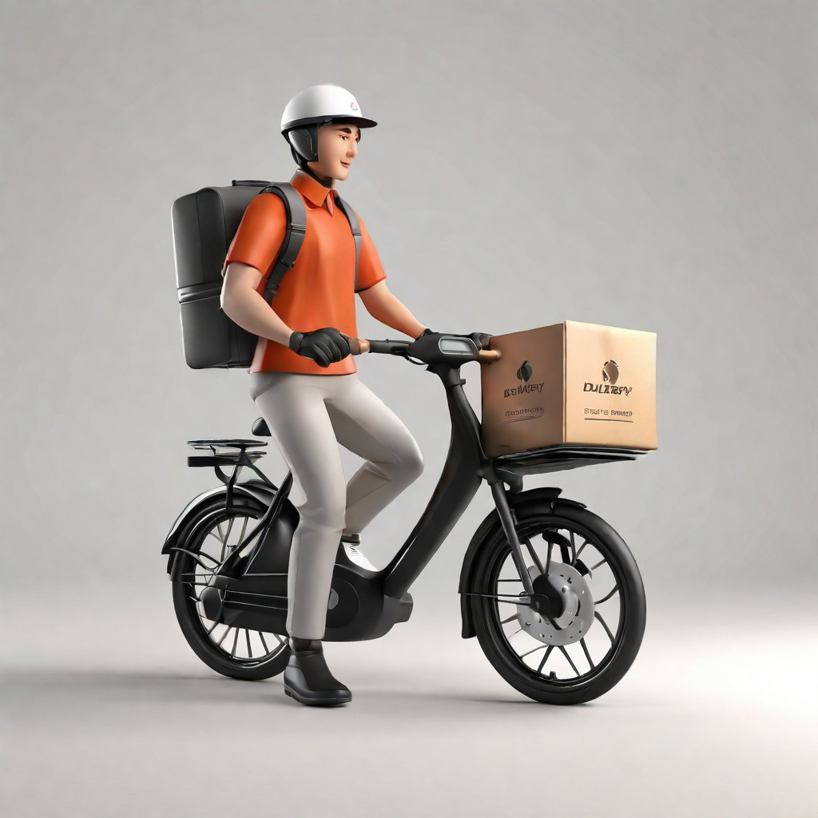

Conclusion
The Swiggy project aims to provide a seamless and enjoyable experience for users looking to order food online. By organizing and managing restaurant information effectively, the platform strives to connect users with a diverse range of culinary options.

Slide 9

Q & A:
Q1) What’s the source of data?
The data for the Swiggy project collected from INeuron.
Q 2) What was the type of data?
The data was the combination of numerical and Categorical values.
Q 3) What’s the complete flow you followed in this Project?
Refer slide 6th for better Understanding

